Slide 1

Data Analysis Essentials
Cornerstone Project — Second Review
WEB BASED PRODUCT TRACKING SYSTEM
Presented by
[R. Thanuja – Roll No. 25B11AIA34]
[G. Akshaya – Roll No.25B11AI328]
[Y. Aasmitha – Roll No.25B11AID10]
Department
Department of Artificial Intelligence & Machine Learning

Slide 2

Second Review – Project Implementation & Demonstration
2. Python Data Handling
Used Python and Pandas to load, clean, organize and analyze product-tracking records. Prepared structured data for analysis and visualization.
1. Python System Implementation
Developed a working Python-based web product tracking system.
Implemented product search,tracking and status handling.
3. Analysis
Identifies patterns in product categories, prices, ratings, stock status, payment methods, and order trends, helping understand product performance and customer activity..
4. visualization
Visual representation of product categories, stock status, pricing, ratings, and order trends.
5. Data Analysis Results
Product records were cleaned and analyzed using Python. Charts reveal category, order and tracking-status patterns.
6. Presentation
Working Python application, code, analysis charts and system workflow are demonstrated.

Slide 3
Product Tracking
Problem : In traditional product management, tracking product information manually can be difficult. Users may not know the current status or location of their product, while administrators may find it difficult to maintain updated product records.
Objective : To develop a web-based system that allows users and administrators to manage, track and monitor products efficiently.
Domain :
E-Commerce / Product Management / Web Application
Dataset used in this example: 170 raw records, 9 columns; 170 records after duplicate removal.
Main Outcome
A working web application that provides:
Product Registration
→
Product Tracking
→
Status Updates
→
Product Information

Slide 4
DATASET SNAPSHOT — BEFORE & AFTER CLEANING
Check | Before | After
Product Records | 170 | 170
Data Columns | 9 | 9
Missing values | 0 | 0
Duplicate rows | 0 | 0
Data quality | Raw | Cleaned

Slide 5
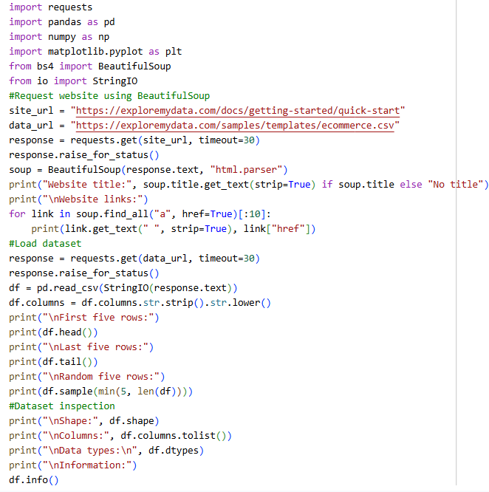
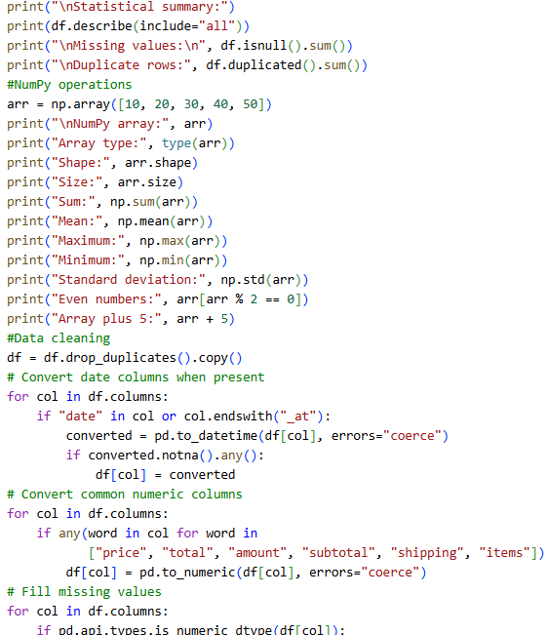

Slide 6
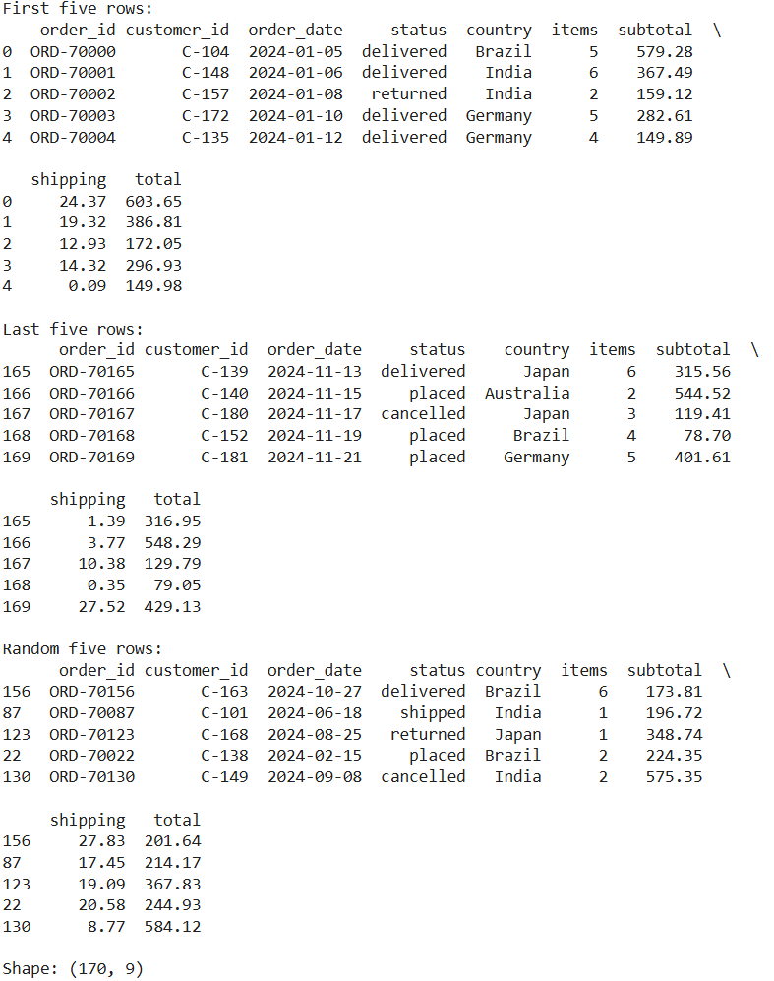
IMPLEMENTATION PYTHON DATA PREPROCESSING
Output for data loading and cleaning
Step 1 — Data Loading
Loaded product-tracking records using Pandas. Checked columns, data types and missing values.
Step 2 — Data Cleaning
Removed duplicate rows.
Handled missing values and converted date fields into usable formats.
Step 3 — Final Check
verified the cleaned dataset shape and column information after processing .
Result
Clean product-tracking dataset ready for exploratory analysis and visualization.

Slide 7
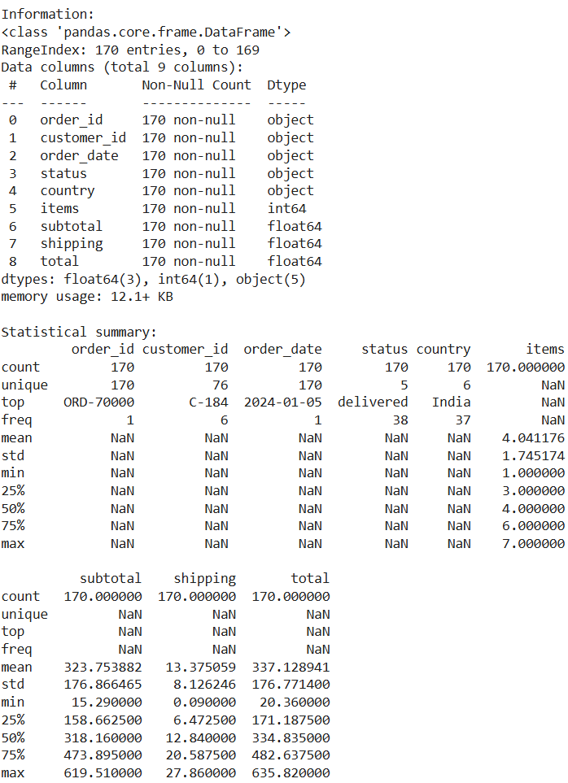
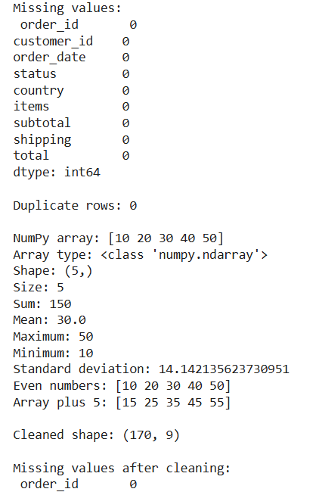

Slide 8
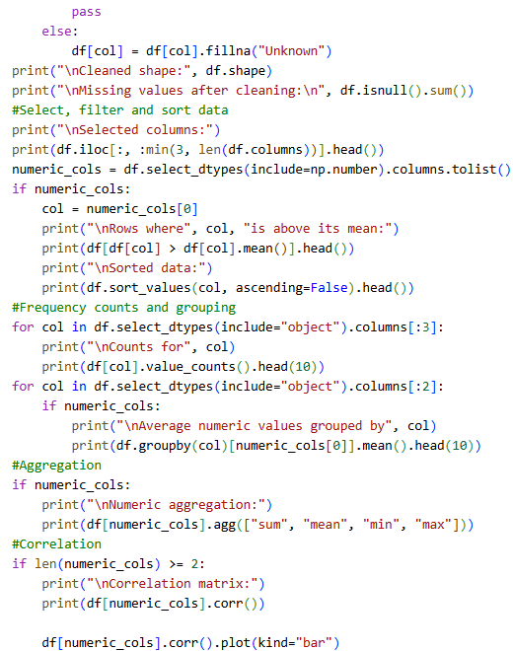
PROJECT IMPLEMENTATION — PYTHON
Python Architecture
Web Browser → Python Web Application → Pandas Processing → Analysis / Output
Python Modules
Pandas
NumPy
Matplotlib
Data Processing
CSV/structured product records → Pandas DataFrame → Cleaning → EDA → Visualization
Execution
User searches product → Python processes the request → product status is retrieved → result is displayed.

Slide 9
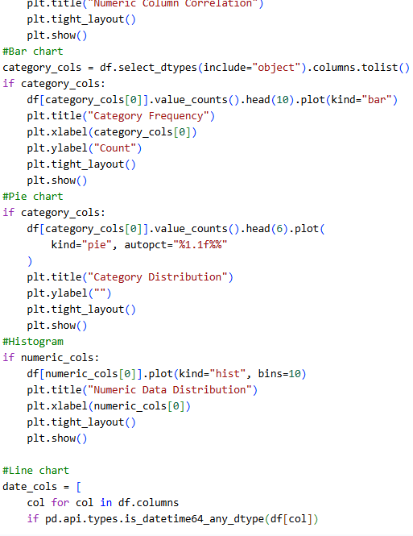
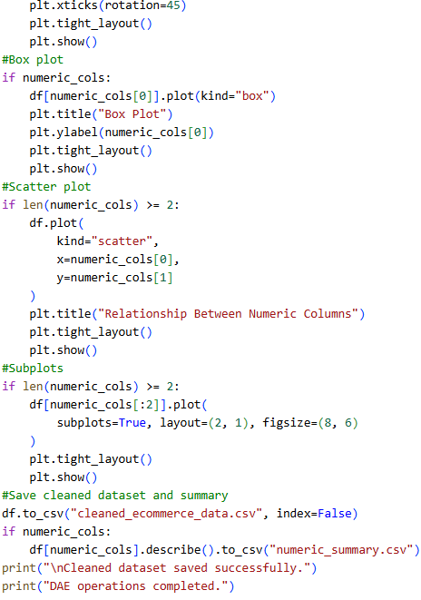

Slide 10
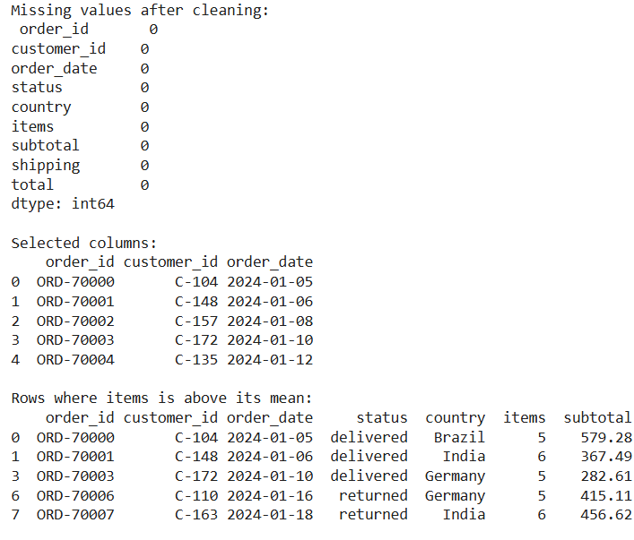
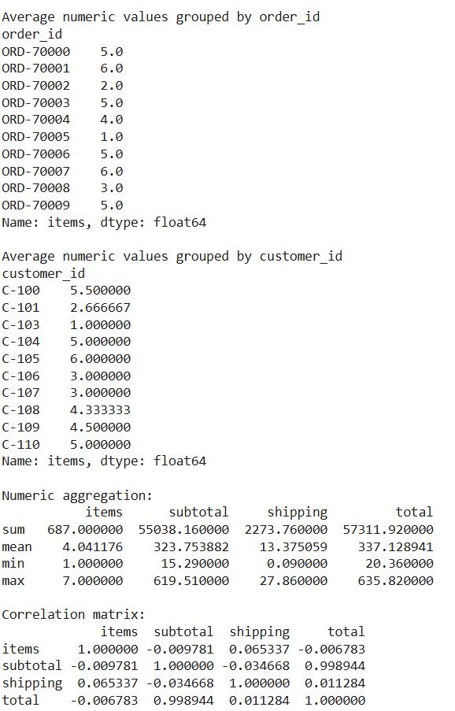

Slide 11
VISUALIZATION & INTERPRETATION
Product Category Distribution
Pandas and Matplotlib show how products are distributed across categories.
Tracking Status
Cooparates orders across Ordered, Processing, Shipped and Delivered stages.
Order Trend
Shows monthly order activity and helps identify changes over time.
Importance
It helps ensure accurate data processing, meaningful analysis, and clear presentation of product-tracking information
Delivery Analysis
Compares delivered, in-progress and pending orders.
Example interpretation:
Python-based EDA makes product and order patterns easier to identify and explain.
Visual findings support the project objective and help demonstrate the value of data analysis.

Slide 12
RESULTS & KEY INSIGHTS
Python successfully loads, cleans and organizes product-tracking records.
EDA identifies useful patterns in product categories, order activity and tracking status.
The Python web module allows users to search for a product and view its current status.
Python Processing
Pandas
Visualization
Matplotlib
Web Application
Working
The completed DAE pipeline moves from raw product records → Python data loading → cleaning → EDA → visualization → web output.
The analysis provides evidence about product distribution, order activity and tracking progress.

Slide 13
PROJECT REPORT & PRESENTATION EVIDENCE
Data presentation
The processed data is presented through clear tables and visualizations for easy understanding and interpretation
Missing handling values
Missing values are identified and appropriately handled to maintain data quality and consistency
Python Code
Python code is organized into data loading,
cleaning, analysis and web-application sections.
Data cleaning
The dataset is cleaned by removing duplicates, handling missing values, and standardizing data for accurate analysis
Data set
The final dataset is clean, structured, and ready for analysis and visualization
implementation evidence
The implementation is demonstrated through the Python code, data processing steps, analysis outputs, and visualizations

Slide 14
COMPLETED PROJECT WORKFLOW
Raw Product Data
Data Inspection
Data Preparation
EDA
Visualization
Python Web Output
Tracking Result
Insights / Report
Raw Product Data: The original product dataset is collected from the source.
Data Inspection: The dataset’s rows, columns, data types, missing values, and duplicates are checked.
Data Preparation: The data is cleaned and prepared for analysis.
EDA: Exploratory Data Analysis is performed to identify patterns and trends.
Visualization: Charts and graphs are created to represent product data clearly.
Python Web Output: Python results are presented through a web-based output.
Tracking Result: Product details and analysis results are reviewed to understand product performance.
Insights / Report: The findings are summarized and documented in the final project report.

Slide 15
CONCLUSION — SECOND REVIEW
The Web Based Product Tracking System successfully manages and analyzes product-tracking data.
Python and Pandas are used to clean, organize, and process the dataset.
The system handles missing values, duplicate records, and date-related data.
EDA helps identify patterns in product categories, pricing, ratings, and stock status.
Visualizations make product and order trends easier to understand.
The web-based module allows users to search products and view their tracking status.
Overall, the project provides a structured and efficient approach to product tracking and data analysis.
Final message
Review-2 = Demonstrate the Python implementation, what the data showed, how the system works, and what the project achieved.

Slide 16
THANK YOU

